Slide 1

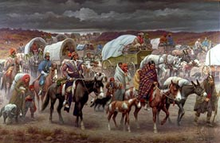
The Indian Removal

Slide 2
1700’s-1800’s
Georgia wanted to improve the state’s economy and add more land
As the population of settlers in the state of Ga. increased, the demand for land began to affect the native Indian population.
From 1783-1838 Indians were forced out of their traditional lands

Slide 3
Conflicting Views
NATIVE AMERICANS
Originally the belief was there would be enough land for both Indians and whites
Indians believed one could not own land. You could manage it and use it.
Tribes respected this. Once stop using that land lost right to it.

Slide 4
Conflicting Views
WHITE SETTLERS
Land was something that could be bought, sold or inherited
After Louisiana Purchase in 1803
Many felt Indians should move west.
Notes:
But as more people moved in and ownership of land differed conflicts arose
Indians believed couldn’t own land, air or water
Before the American Revolution Indians lands protected by British
After war Indian rights eroded
1803

Slide 5
Georgia’s Major Tribes
Creek Choctaws
Cherokee Chickasaws
These 4 along with the Seminoles in Florida became known as the Five Civilized Tribes because they adopted many characteristics of white culture
They thought it would help them hold on to their native land
Notes:
Choctaw the largest tribe in Georgia-land in west Georgia
Creeks and Cherokee controlled most of the land

Slide 6
Creeks
Creeks-not a single tribe but a confederation of tribes
Also known as Muscogee
2 groups:
Upper Creek-lived in northern Ala.
Lower Creeks-west Ga., southern
Ala. and northern Fla. included
Tomochichi and the Yamacraw’s

Slide 7
Creeks
Upper Creeks: wanted their land back –led by McGillivary–red sticks (Oconee War)
Lower Creeks: wanted to turn land over to whites-friendly with U.S.-white sticks

Slide 8
WARS
Indians cede their lands
Yamasee War
French and Indian War
Oconee War
War of 1812
Creek land being ceded away
Indians became divided among themselves
Some groups of Creek signed treaties with whites asking tribes to agree

Slide 9
Proclamation of 1763
Certain boundaries were established country divided into 2 parts
Colonists were to remain east of the Appalachian Mts.
Indians were to have the area west of the Appalachian Mts.
Ga. boundaries expand now to-Mississippi and Alabama

Slide 10
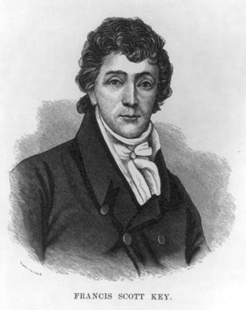
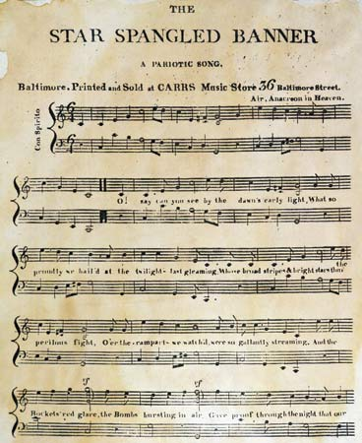
Francis Scott Key
Star Spangled Banner

Slide 11
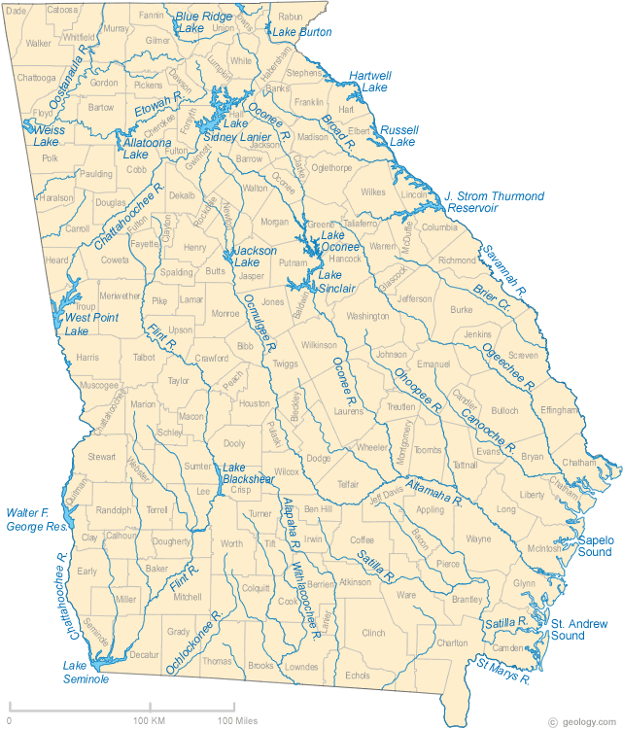
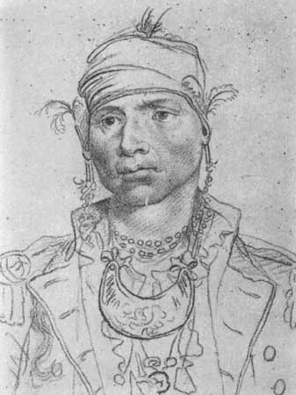
Alexander McGillivary
Upper Creek chief
Upper Creeks against giving up land
1790 went to Washington persuaded to cede land between Oconee and Ogeechee rivers
Oconee Ogeechee
In return for treaty Creeks received money and other goods

Slide 12
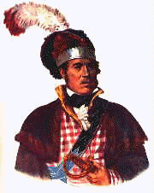
Chief William McIntosh
Lower Creek Chief
Fought with Andrew Jackson at Horseshoe Bend
Treaty of Indian Springs
which sold away the last of the Creek Indian lands in Georgia for $400,000
Killed by his people for doing so

Slide 13
Cherokee
Next came the Cherokee to be removed-
they lived in north Ga. N.C., Tenn., and Ala.
Considered the most “civilized” had adopted a lot of “white” ways

Slide 14
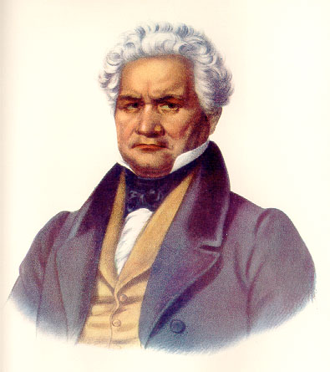
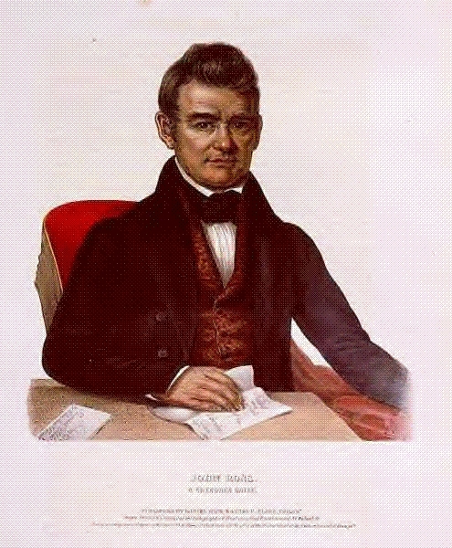
Major Ridge and John Ross shared a vision of the Cherokee Nation that it could maintain its separate culture and still coexist with its white neighbors.
They worked together to create a capitol for their
tribe, at New Echota.
A written constitution put the tribe on an equal footing with the whites in terms of self government.
The constitution was modeled on that of the United States.

Slide 15
In an attempt to save their homeland Cherokee formed a nation that stretched across five states
Cherokee Phoenix-newspaper-bilingual
Georgia refused to recognize the Cherokee government

Slide 16
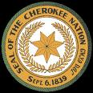
Settlers wanted Cherokee removed
Two reasons were-
1. Homestead the land
2. Mine for gold

Slide 17
1828- Cherokees had adapted to European style customs
clothing
roads, schools, churches, representative government, large houses,farmers, ranchers

Slide 18
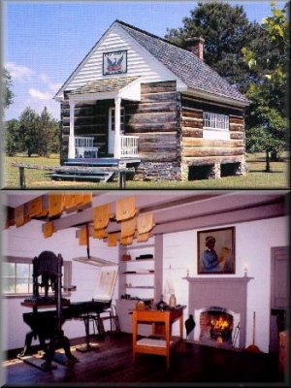
The Cherokee national newspaper, The Cherokee Phoenix, was first printed in1828 at New Echota (near present Calhoun, GA) with Elias Boudinot as editor. The paper was printed in both Cherokee and English and became popular in the United States and Europe.

Slide 19
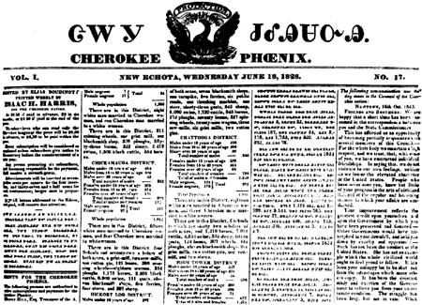
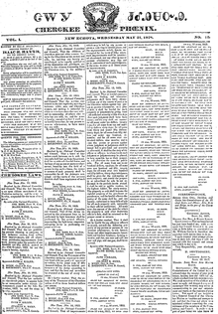

Slide 20
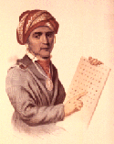
Contributions
Sequoyah’s syllabary- George Gist
father a scout, mother a Cherokee
pig’s foot
Cherokee’s unable to write letters home, read military orders, record events
Used a phonetic system-sound represented by a symbol-

Slide 21
Talking leaves
Took almost 12 years- 85 letters make up the Cherokee alphabet
1821 Cherokee adopted his syllabary-to show whites’ didn’t need their written language
Within months thousands of Cherokee’s became literate

Slide 22
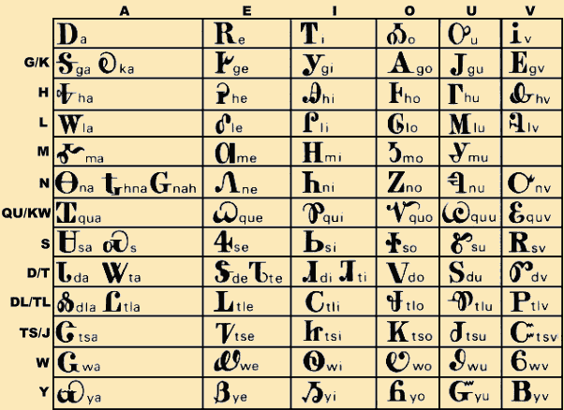

Slide 23
Cherokee Government
Similarities to the U.S. Government
Constitution
Three branches of government
Elected to office-principal chief
Bicameral legislature
Superior court
U.S. Constitution didn’t allow a nation within a state without that state gov’t’s approval

Slide 24
1828-State of Georgia wouldn’t recognize the “Cherokee Nation”
Declared Cherokee laws “null and void”
Andrew Jackson becomes President and his reply to the Indians was to move west.

Slide 25
Reasons for removal
This demand for land and its limited supply that eventually led to Indian removal.
Discovery of gold in 1828 brought on another land rush. Thousands of whites moved into north Ga. In search of gold.

Slide 26

GOLD!
Gold discovered in Dahlonega in 1829. The first gold mining center in the United States.
Ga. legislature placed Cherokee land under state control.

Slide 27
Worcester vs. Georgia 1832
Whites living in Cherokee land take an oath of allegiance
White missionaries refused to take oath and were arrested
Sentenced to 4 years prison
Case goes to the Supreme Court
Chief Justice John Marshall of the Supreme
Court his decision: Ga. Law does not apply to the Cherokee Nation
Missionaries should be freed
it did not protect the Cherokees from being removed from their homeland in the Southeast.

Slide 28
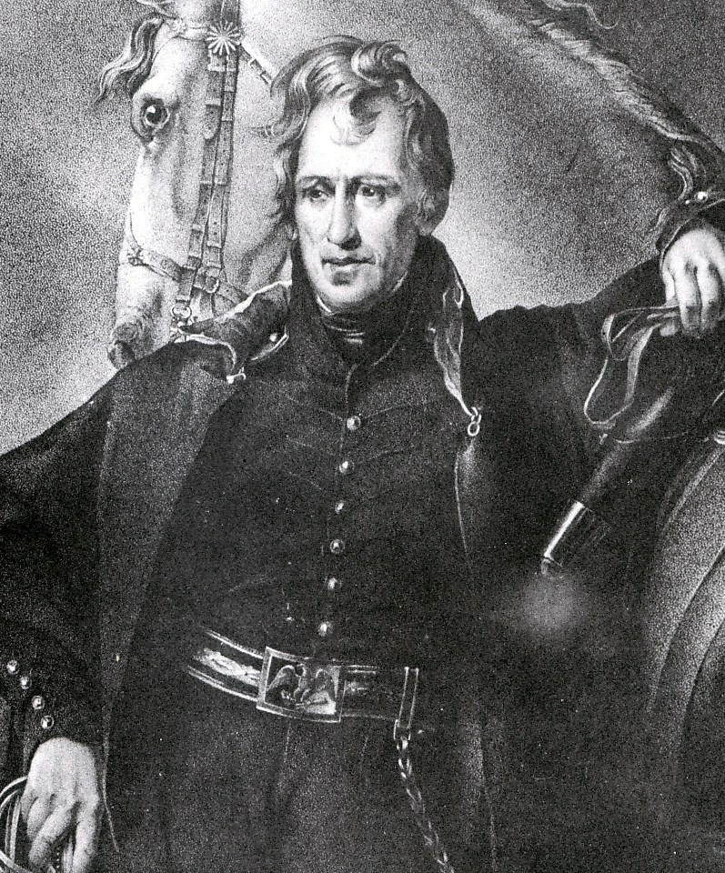
Indian Removal Act 1830
1830
Pres. Andrew Jackson signs a bill removing all southeastern tribes to the west.

Slide 29
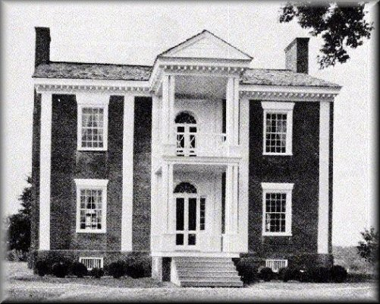
The Vann House at Springplace GA was built by James Vann and inherited by his son Joseph "Rich Joe" Vann. In 1833, his mansion was confiscated by the Georgia Guard (militia) was turned into Georgia Guard headquarters. At the time of removal, Rich Joe's property valuation showed him as the second richest man in the Nation.

Slide 30
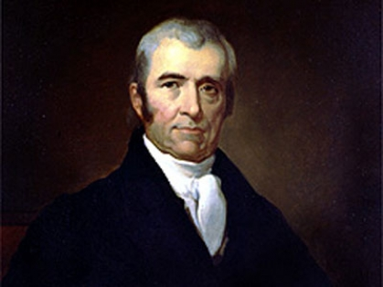
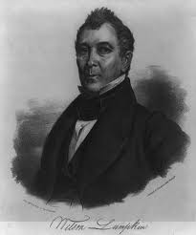
Ga.’s governor: Wilson Lumpkin ignored Supreme Court ruling
“John Marshall has made his ruling now let him enforce it”
Supreme Court Justice Wilson Lumpkin
John Marshall governor of Ga.

Slide 31
Removal of Indians
1835 Indian lands were ceded
1838 United States troops forced the last of the Cherokee’s in Ga. to Oklahoma
Increased demand for land and its limited supply led to the removal of all Native American to Oklahoma

Slide 32
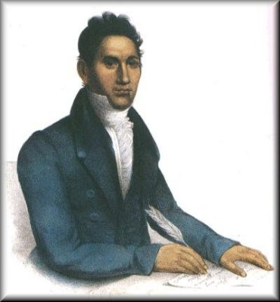
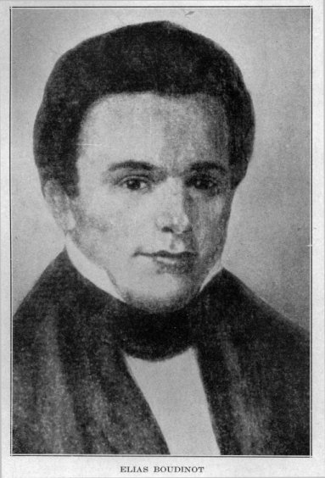
Cherokee leaders in favor of moving
Major Ridge, his son John Ridge (killed) and Elias Boudinot believed it was better for their people to move west.
In 1835 they signed the Treaty of New Echota agreeing to move west and in return received $5 million

Slide 33
Chief John Ross
One of the richest men in North Georgia before 1838, had a number of ventures including a 200-acre farm and owned a number of slaves.
Led the fight against removal of the Cherokee people
Led his people to their exile in Oklahoma

Slide 34
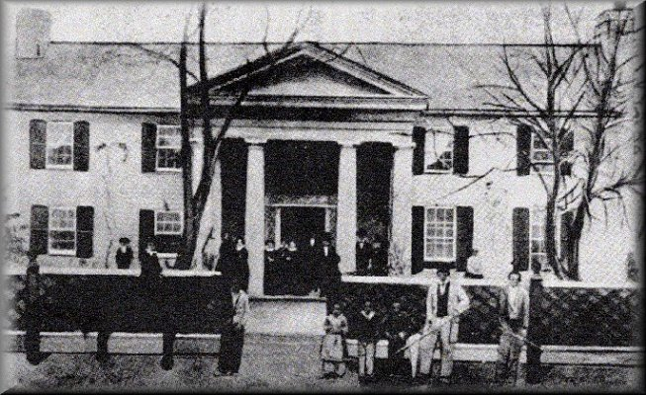
Rose Cottage was Chief John Ross's plantation home In 1862, after Ross's "capture" by Union troops the house was ordered to be burned

Slide 35
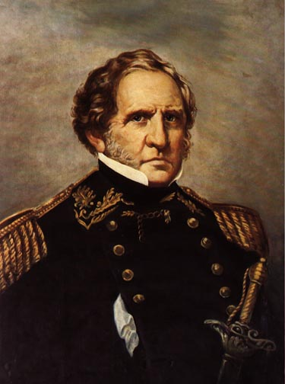
General Winfield Scott
Rounded up the last 15,000 Cherokee in Georgia
Some Cherokee escaped to the mountains of North Carolina

Slide 36
Trail of Tears
1838 troops arrived in New Echota.
Indians placed in stockades, many died while there.
Summer-began the 700-800 mile walk to Oklahoma-many died.
Forced removal of Indians of Cherokee from Georgia to Oklahoma(Indian territory)

Slide 37
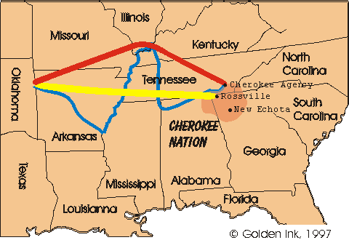
Routes of Indian Removal

Slide 38
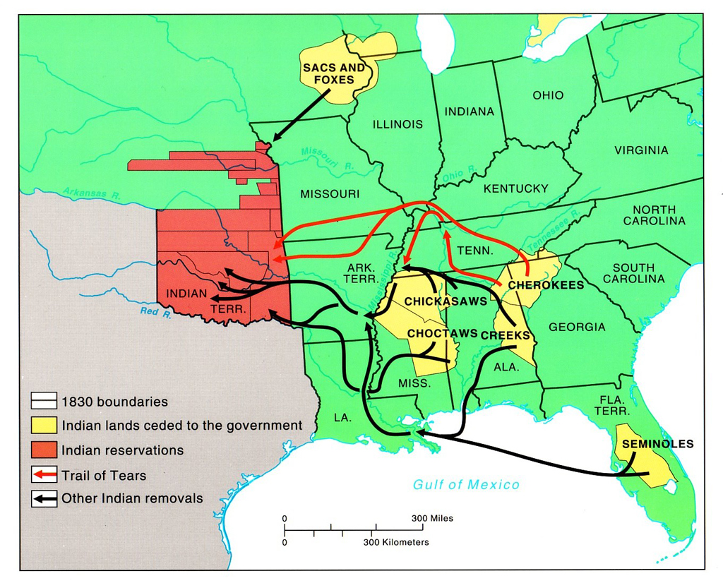

Slide 39
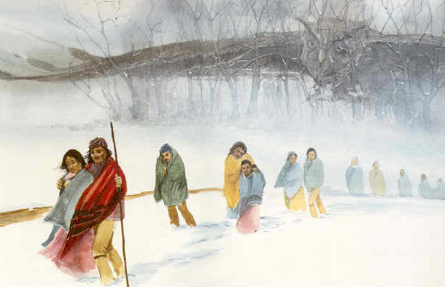

Slide 40
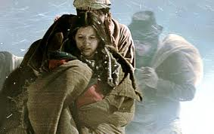

Slide 41
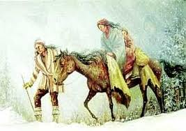

Slide 42
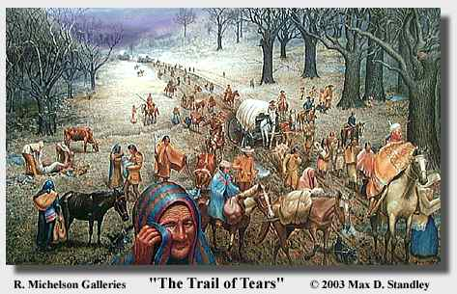

Slide 43
