Slide 1
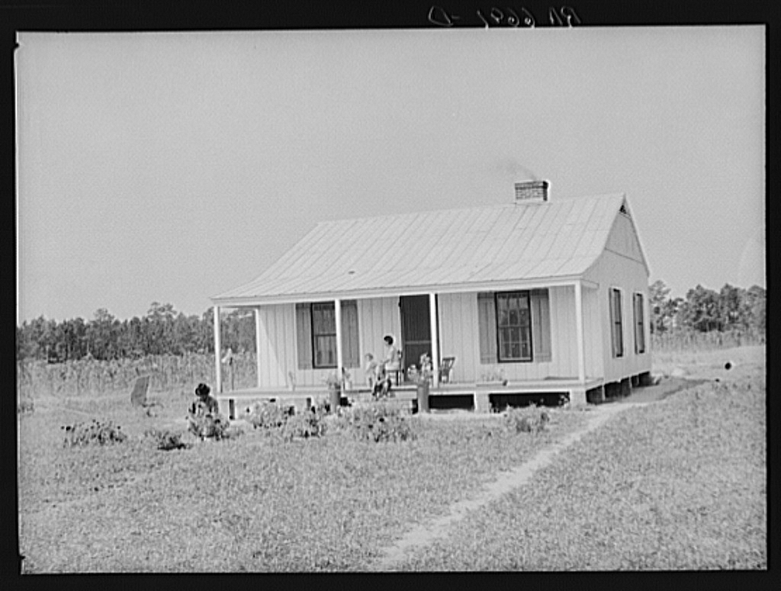
Causes and Effects of the Great Depression in Georgia
Explain economic factors that resulted in the Great Depression.

Slide 2
Article: The Boll weevil
Read the article on the Boll weevil
Write the title of the article in your composition book and then…
In your composition book, record at least five questions ( and answers) that other students should be able to answer from the reading. Your questions should focus on the impact of the boll weevil on Georgia.

Slide 3
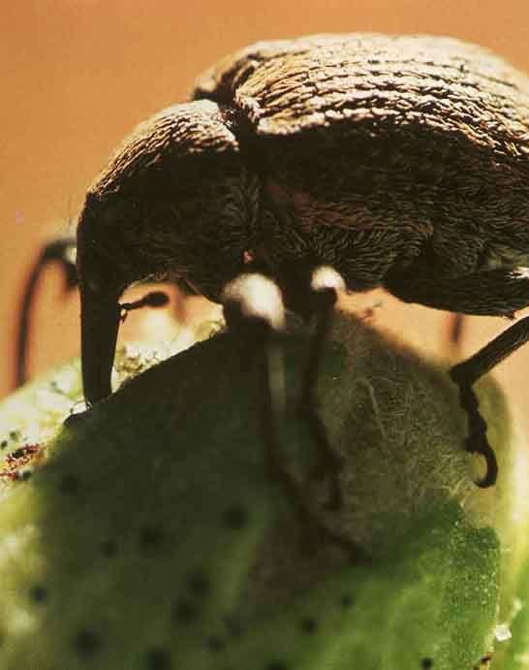
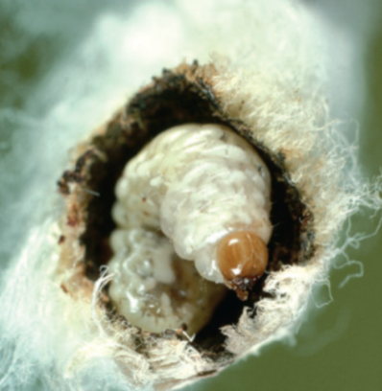
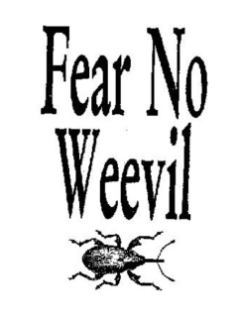

Slide 4
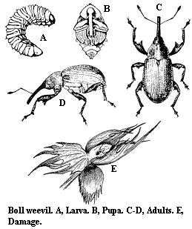
Boll Weevil
The boll weevil is an insect whose larva feeds on the cotton plant.
Due to the destruction caused by the boll weevil, Georgia cotton farmers went from producing “5.2 million acres of cotton in 1914 to 2.6 million acres in 1923.

Slide 5

CAUSE
Migrated from Mexico
Infested cotton growing areas in the 1920s
BOLL WEEVIL
Beetle
Feeds on cotton
EFFECT
Destroyed cotton crops decreasing production
Sharecroppers, tenant farmers, and African Americans lost their jobs, some moved north
Agricultural pest
Helped diversify agriculture
Cotton no longer the primary crop

Slide 6
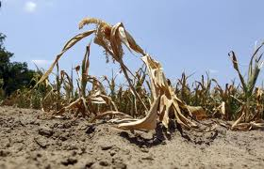
Drought
In addition to the damage caused by the boll weevil, Georgia farmers suffered through another natural disaster in the 1920’s and 1930’s: drought.
The worst droughts in Georgia history were from 1924-1927 and 1930-1935.

Slide 7
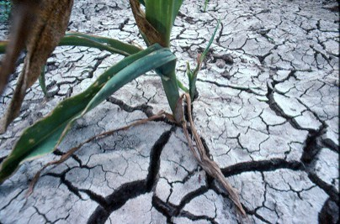
1924-1927 DROUGHT IN GEORGIA
DROUGHT
EFFECT
Farmers went into debt
Food shortage
Agricultural related businesses struggle
Farmers (sharecroppers) move to urban areas
Lack of rainfall over extended period of time
Georgia was in an economic depression before the rest of the country

Slide 8
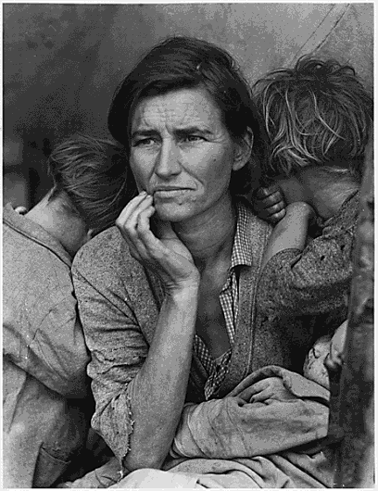

ESSENTIAL QUESTION
notes
SS8H8b
WHAT CAUSED THE GREAT DEPRESSION?
Notes:
8
8

Slide 9
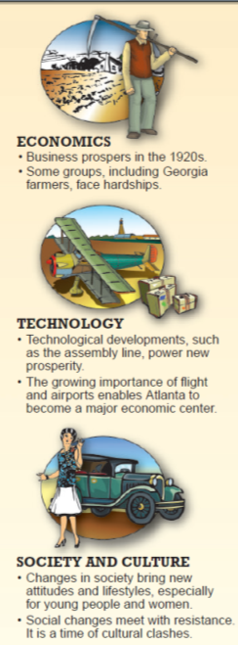

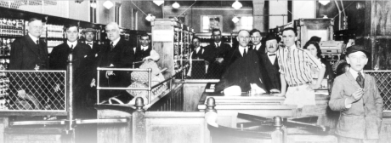
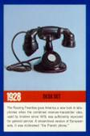
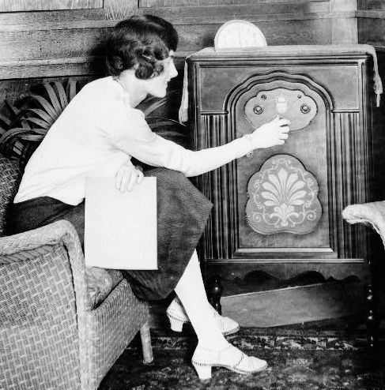
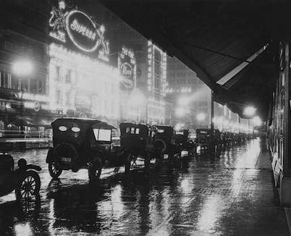
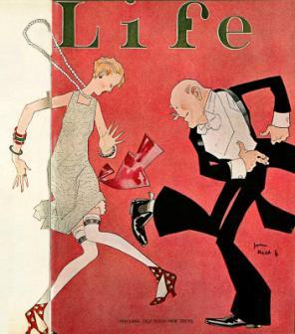
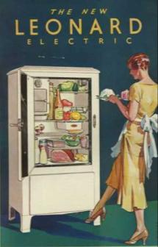
THE ROARING 20s – AMERICANS BECOME RICH
The 1920s were an age of dramatic social and political change. For the first time, more Americans lived in cities than on farms. The nation’s total wealth more than doubled between 1920 and 1929, and this economic growth swept many Americans into an affluent but unfamiliar “consumer society.” People from coast to coast bought the same goods (thanks to nationwide advertising and the spread of chain stores), listened to the same music, did the same dances and even used the same slang!
WWW.HISTORYCHANNEL.COM

Slide 10
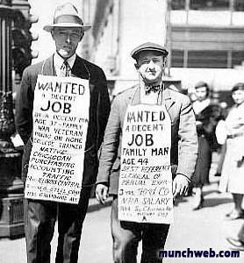
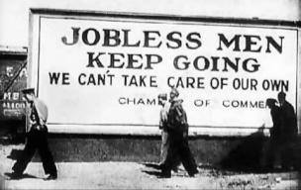

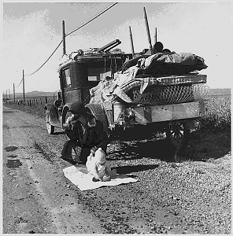
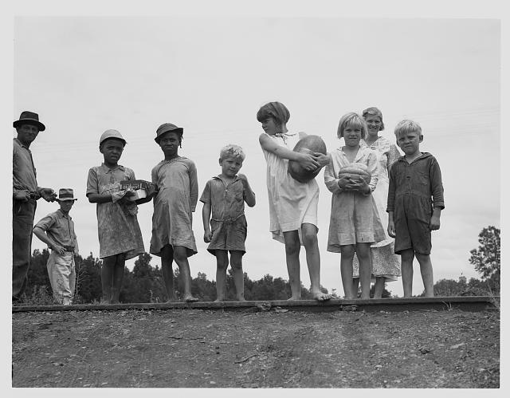
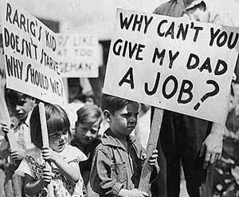
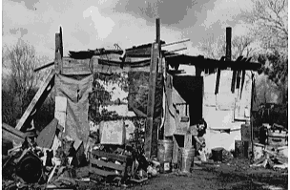
THE GREAT DEPRESSION
THE 1930s

Slide 11
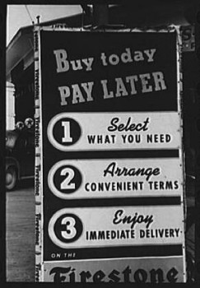
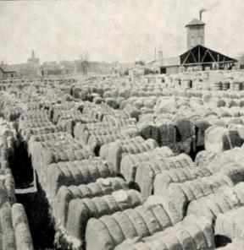
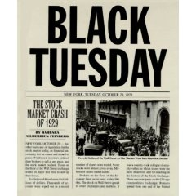
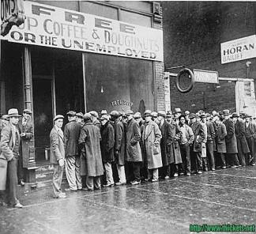
STOCK MARKET CRASH
Banks, Businesses, and Investors all lost money
GREAT DEPRESSION
Unemployment was 25%, economy was weak
OVER PRODUCTION
Farmers and Businesses made too many products that did not get sold
TOO MUCH CREDIT
Americans borrowing money from banks, getting into debt
ECONOMIC FACTORS OF THE GREAT DEPRESSION

Slide 12
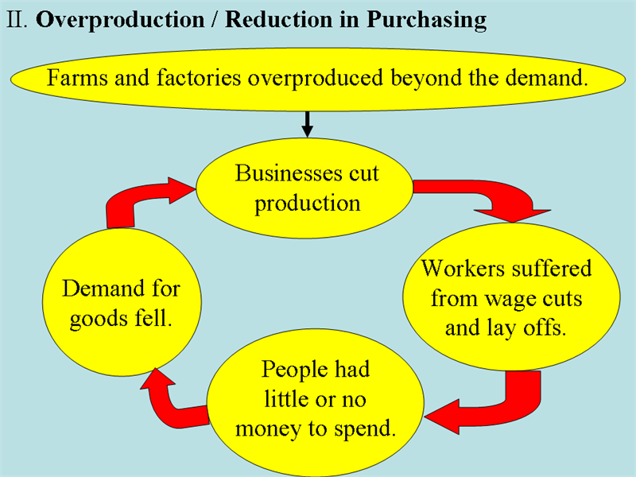
OVERPRODUCTION OF INDUSTRIAL AND AGRICULTURAL PRODUCTS

Slide 13
STOCK MARKET CRASH
Banks, Businesses, and Investors all lost money
GREAT DEPRESSION
Unemployment was 25%, economy was weak
OVER PRODUCTION
Farmers and Businesses made too many products that did not get sold
TOO MUCH CREDIT
Americans borrowing money from banks, getting into debt
ECONOMIC FACTORS OF THE GREAT DEPRESSION

Slide 14
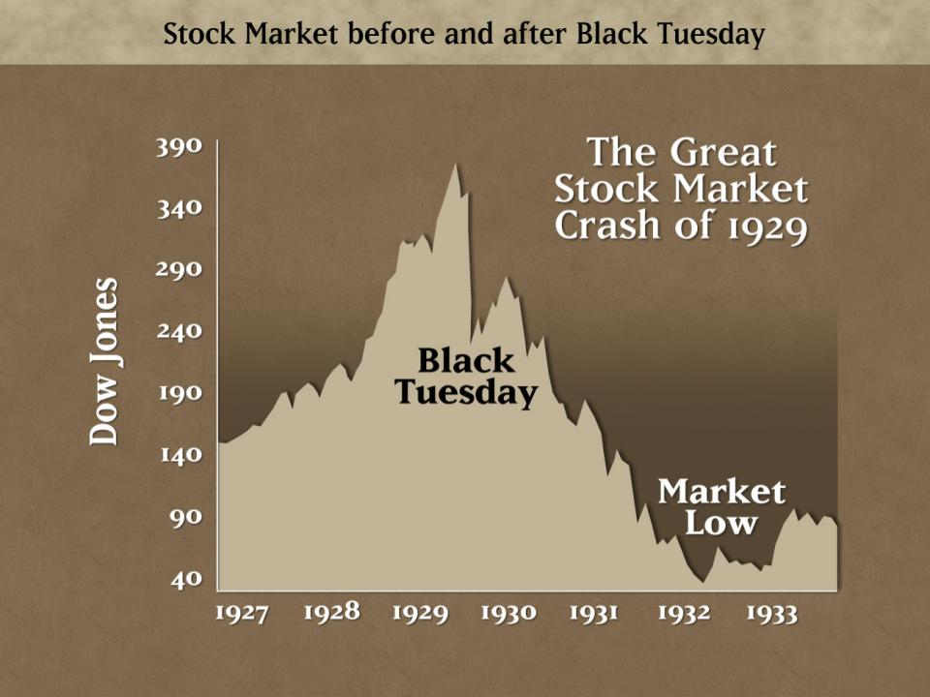
http://bit.do/grdep
http://www.neilpeterson.com/wp-content/uploads/2009/03/stock-market-crash-1929.jpg

Slide 15
Over Production of Agricultural Products
In the 1920s Midwestern farmers produced record numbers of agricultural products.
However, this over-production led to a tremendous drop in the price of agricultural products and dramatically limited the profit margins of farmers.
During a period of time where millions were starving, farmers destroyed much needed food or stopped growing crops all together in order attempt to raise the price of agricultural products.

Slide 16
STOCK MARKET CRASH
Banks, Businesses, and Investors all lost money
GREAT DEPRESSION
Unemployment was 25%, economy was weak
OVER PRODUCTION
Farmers and Businesses made too many products that did not get sold
TOO MUCH CREDIT
Americans borrowing money from banks, getting into debt
ECONOMIC FACTORS OF THE GREAT DEPRESSION

Slide 17
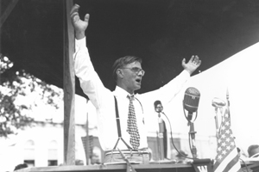
Eugene Talmadge
In his gubernatorial election campaigns of the 1930’s Eugene Talmadge, wearing red suspenders and rounded glasses, promised Georgia’s rural voters that they had three friends in the world “the Sears Roebuck Company, God almighty, and Eugene Herman Talmadge of Sugar Hill, Georgia.”
http://tinyurl.com/EugTal

Slide 18
Pros and Cons of Eugene Talmadge
Pros:
Extremely popular among rural Georgians
Strong supporter of farmers
Lowered utility costs
Lowered car tag rates
Cons:
Fought against New Deal Policies
Supported County Unit System
Caused University System to lose accreditation
Promoted segregationist policies

Slide 19
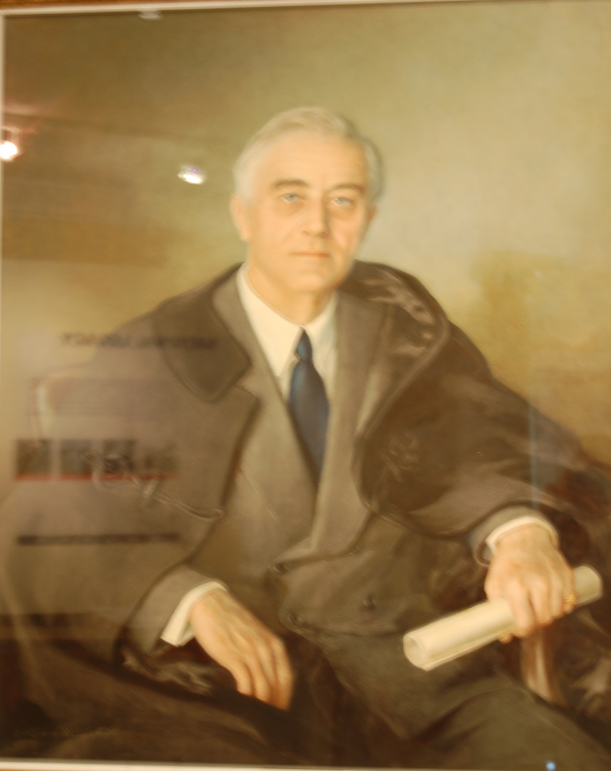
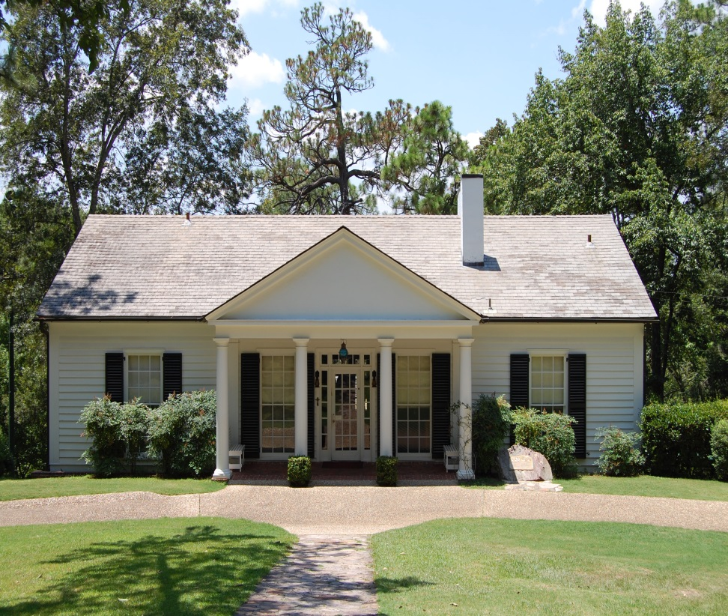
Franklin D. Roosevelt
http://tinyurl.com/EVEROOSE

Slide 20
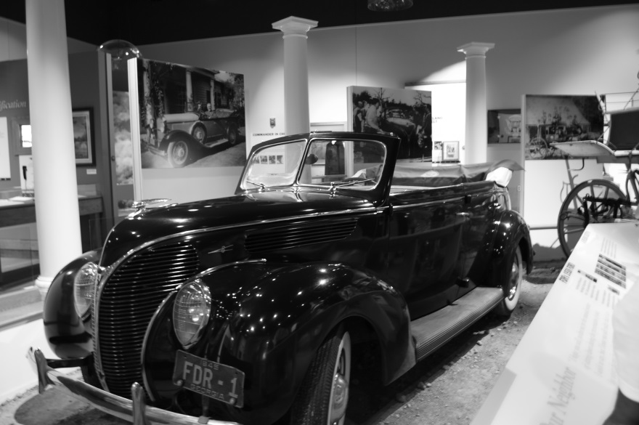
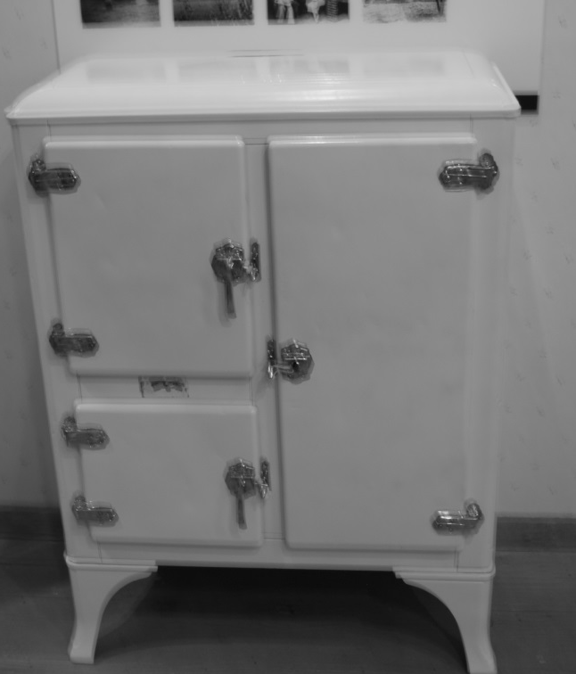
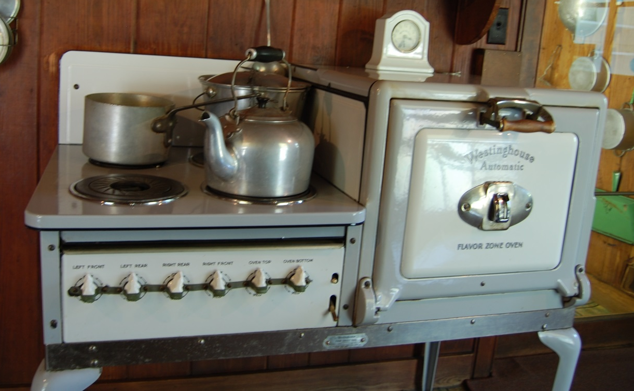
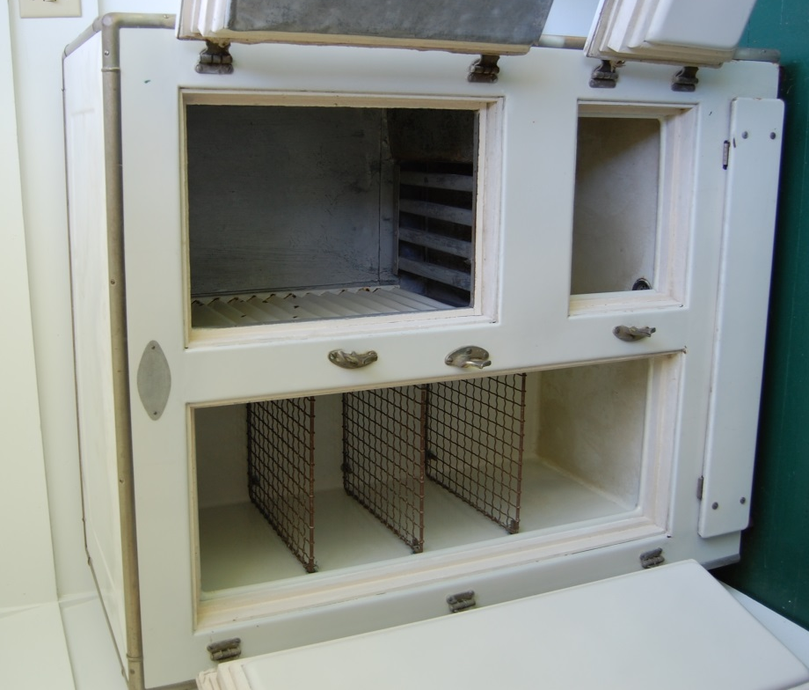

Slide 21
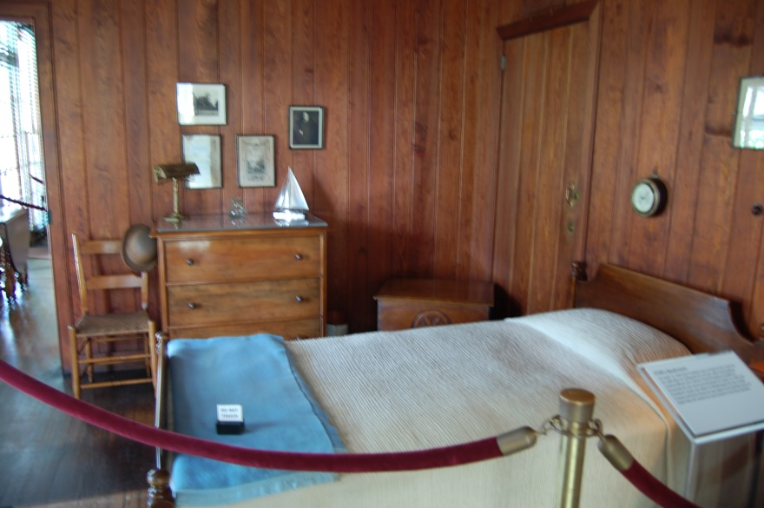
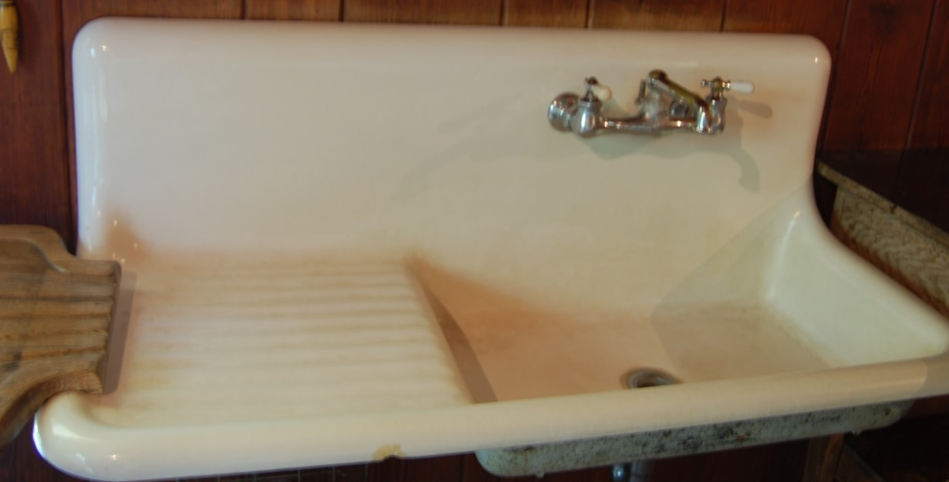
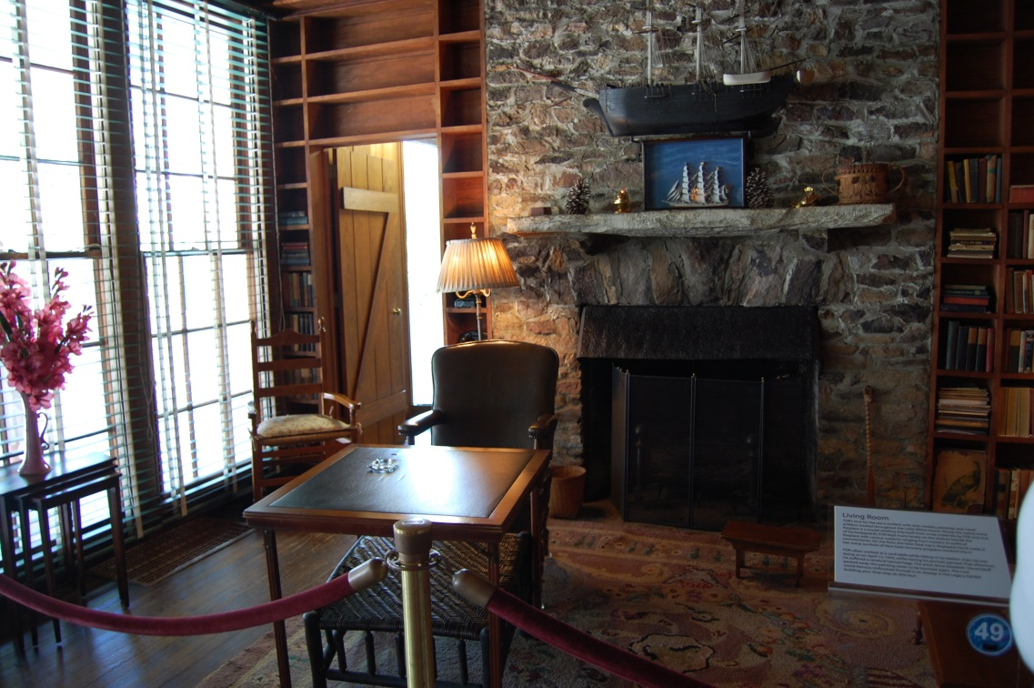
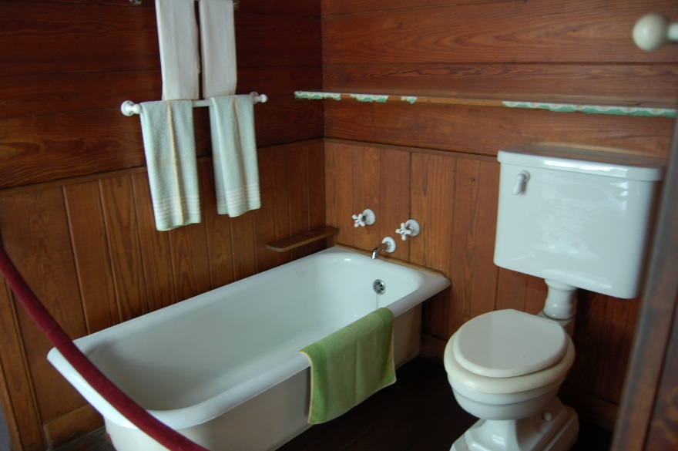

Slide 22
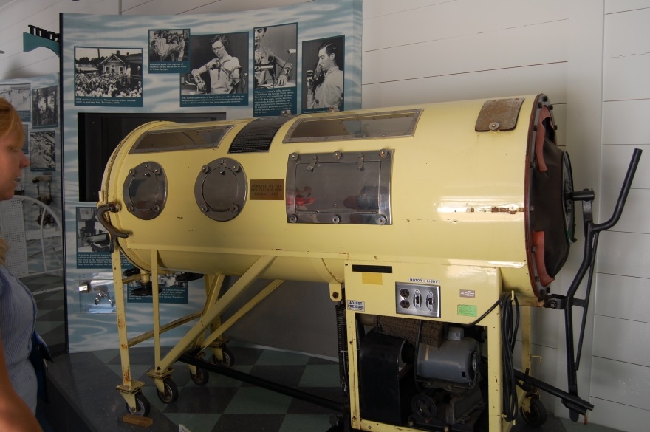
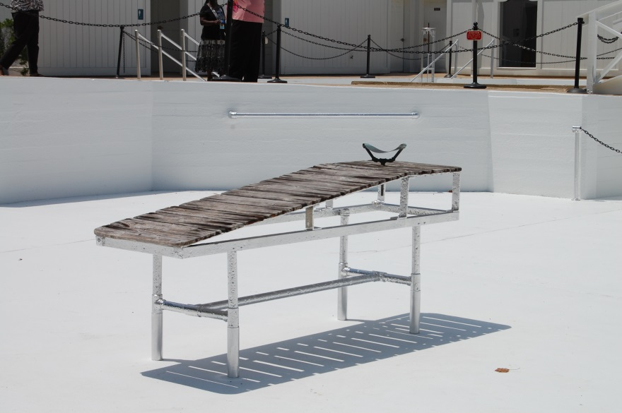
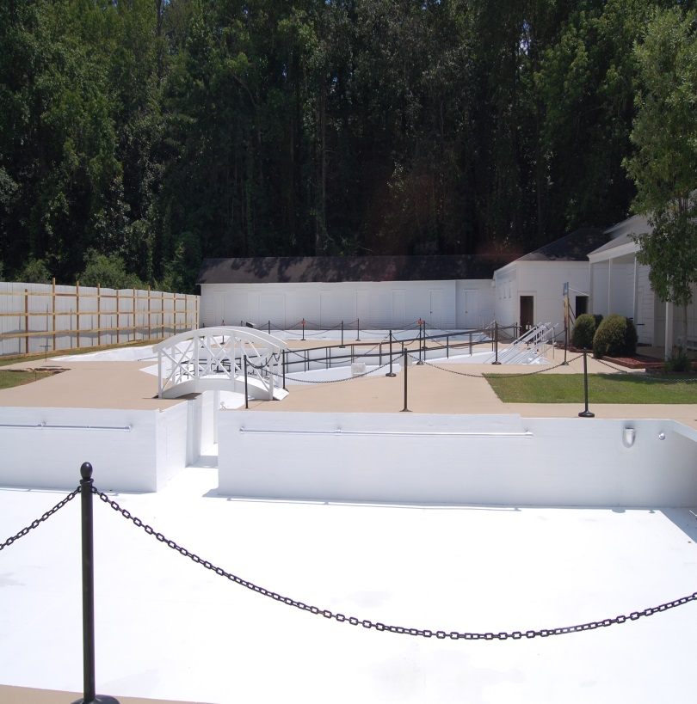
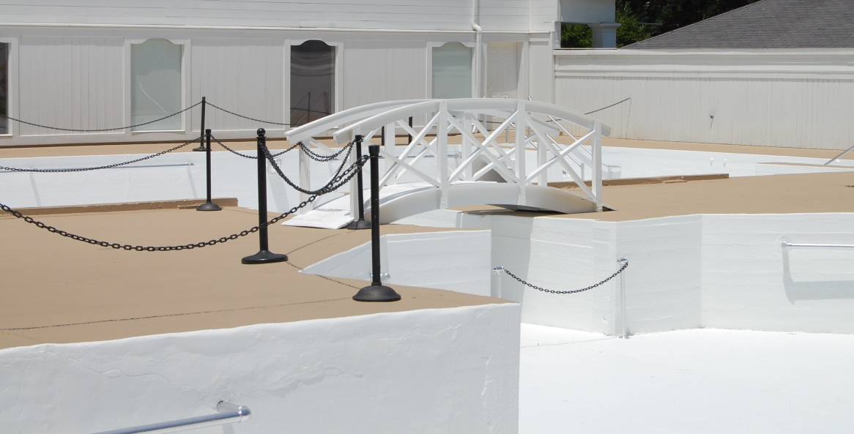
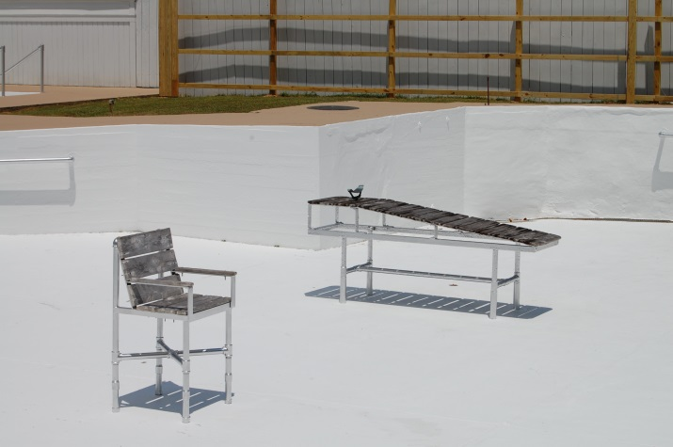

Slide 23
Franklin Roosevelt
Went to Warm Springs, GA. (the Little White House) for polio treatments
He was respected by Georgians because of his New Deal Program

Slide 24
The New Deal
Though Georgia voters supported Governor Eugene Talmadge, a critic of the New Deal, Georgians also supported President Franklin Roosevelt and his New Deal programs throughout the Great Depression.
The New Deal Programs provided aid and support to many poor Georgians.
Though these programs did not end the Great Depression, they helped many poor Georgians cope during the difficult economic times.

Slide 25
The Civilian Conservation Corps (CCC)
The purpose of the program was to hire unemployed young men to work on public service projects.
Some of these projects included erosion control, flood prevention, and public parks.
Men who volunteered for this service signed six month contracts and were provided room and board.
In addition, they also received $30 a month, $25 of which had to be sent back to their families

Slide 26
The CCC in GA
78,000 Georgians were employed by the CCC and these men planted over 22 million trees and built or improved several state parks.
These parks are still used today, including historic battle fields such as Chickamauga and Kennesaw Mountain, and “forest parks” such as A.H. Stephens and Hard Labor Creek.
Segregation was incorporated in these federal groups. For example, an all black CCC unit helped to develop the infrastructure of the Okefenokee Wildlife Refuge.
When WWII broke out, these men traded their CCC uniforms for army uniforms.

Slide 28
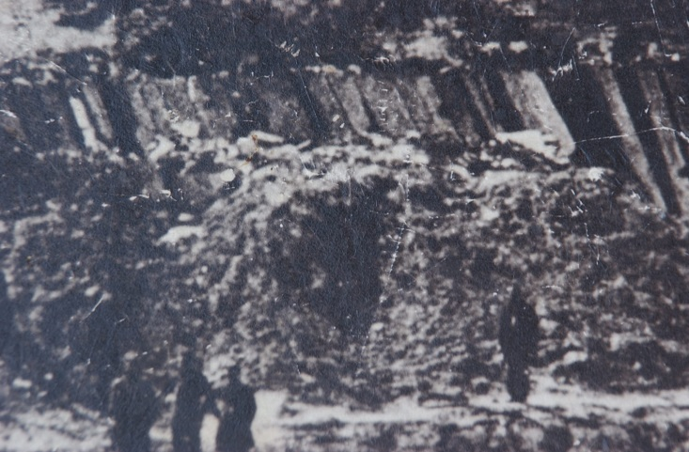
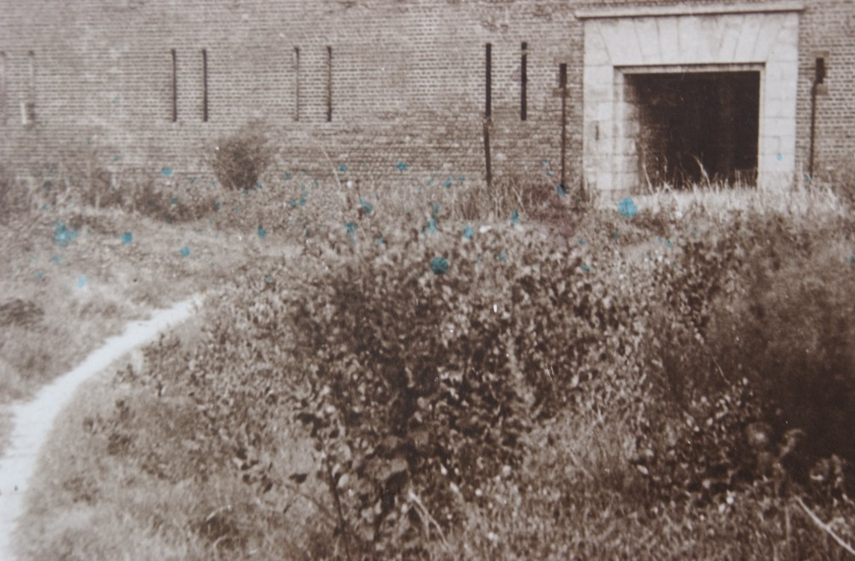
Ft. Pulaski

Slide 29
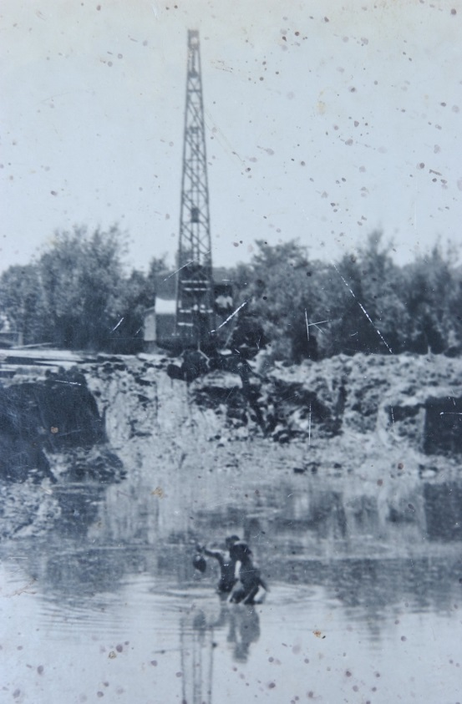
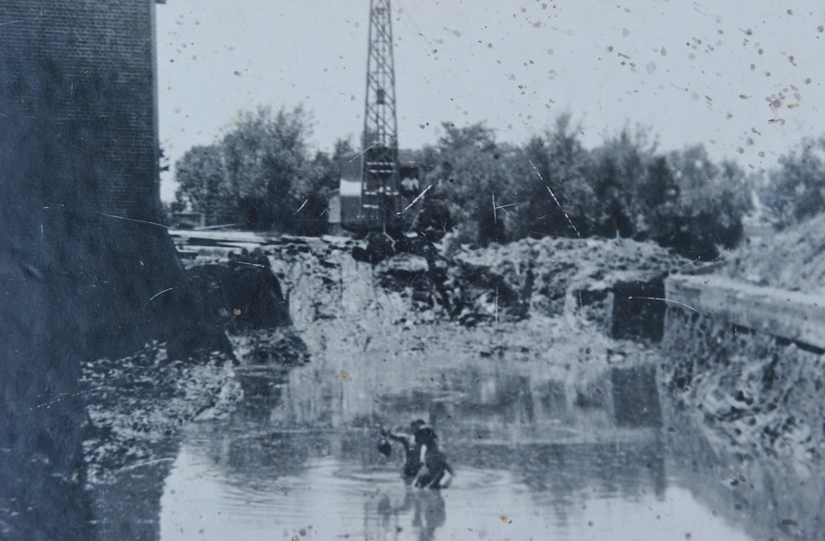

Slide 30
Rural Electrification
Roosevelt had an interest in bringing electricity to all parts of the country.
Only 10% of rural areas had electricity
This act provided loans for rural areas.
Provided work for unemployed workers.
Though many members of Congress and state governors, such as Talmadge, fought against this program, fearing it would lead to socialism, many farmers benefited from it.
http://www.gpb.org/georgiastories/stories/rural_electrification_administration

Slide 31
Agricultural Adjustment Act (AAA)
The basic premise of the AAA was that since so many farmers continued to grow crops such as cotton and tobacco during the Depression, driving the prices of these products down, the federal government paid farmers not to grow those crops.
This caused the price of agriculture products to rise which helped famers make more money and eliminate surplus production.
AAA did just as much harm as good because many GA farmers were sharecroppers or tenant farmers, so land owners just kicked them off the land that was not needed to farm and kept the money the government was reimbursing.
The object was to raise farm prices, but it proved counterproductive for tenant farmers and sharecroppers. It was declared unconstitutional in 1936.

Slide 32
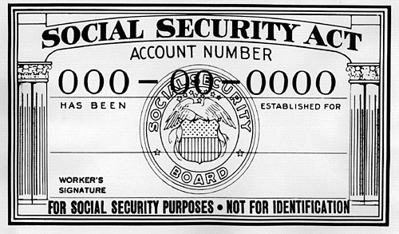
Social Security Act
Designed to help with poverty among senior citizens.
Government provided income to retired and unemployed wage earners.
Georgia didn’t participate until 1937.

Slide 33
Social Security Administration (SSA)
Until 1935, those who were too old or unable to work were dependent on the charity of others.
The Social Security Administration offers benefits for those over 65, those who are disabled, or those who are the survivors of a beneficiary who has died.
This program is one of the longest running of the New Deal, and today most Georgians are connected to the SSA either through paying social security taxes or receiving social security benefits.

Slide 34
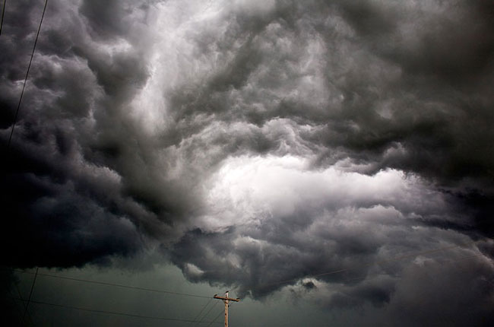
AND THEN
IT
ALL CHANGED
http://tinyurl.com/Greatdp

