Slide 1
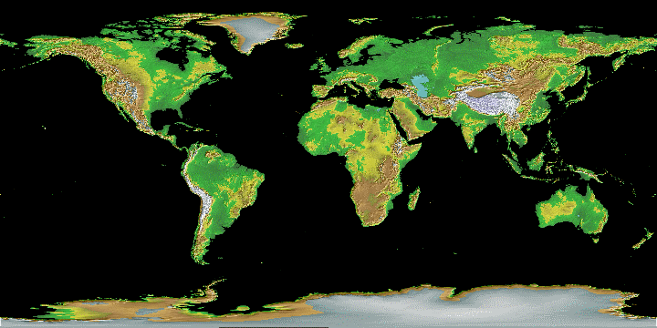
GEORGIA TRADES WITH THE WORLD

Slide 2
COLONIAL ERA (1733-1800)
GOODS: Rice (largest, making up 1/3 of
all GA exports), silk, lumber, indigo,
corn, peas, and naval stores (pitch, tar,
turpentine)
SERVICES: Craftsmen, such as spinners,
weavers, furniture makers, silversmiths,
shoemakers, and dressmakers provided
services, primarily for locals.

Slide 3
ANTEBELLUM ERA (1800-1860)
GOODS: Cotton (“King Cotton”), corn,
tobacco, wheat, oats, sweet potatoes,
honey
SERVICES: Growing industries included
cotton gins, grist mills, textile mills,
sawmills; Savannah became a huge
industrial and shipping center.

Slide 4
POST-WAR TO WWII (1865-1940)
GOODS: Economy was severely
depressed; farmers grew peaches,
watermelons, pecans, and peanuts, but
came to rely on poultry!!!
SERVICES: Growing industries included
cotton textiles, lumber mills, meat
packing (thanks to WWII), and
commercial canning (thanks to WWI).

Slide 5
MODERN GEORGIA (1940-Today)
• By 1950, more people were employed in
manufacturing than agriculture.
• The transportation industry became
extremely important.
• Though poultry, peanuts, and pecans
are still important agricultural products,
Georgia, particularly Atlanta, has become
the business center of the Southeast.

Slide 6
Georgia’s Growing Economy
Time Period | Colonial | Antebellum | Post War | WWII-Today
Goods | silk, rice, peas, indigo, corn, wheat, tobacco | “King Cotton”, corn, tobacco, wheat, oats, sweet potatoes, honey | Severely depressed economy; peaches, peanuts, and POULTRY | Industry & technology; Coca-Cola, poultry, textiles
Services | spinners, weavers, artisans, trade | Cotton gins, grist mills, textile mills, sawmills; Savannah’s port grows | Cotton textiles, lumber mills, meat packing (WW1) and commercial canning (WWII) | Transportation services (travel, UPS, etc.); professional sports, etc.

Slide 7
Georgia’s Trade Throughout History
Time Period | Colonial Era | Antebellum Era | 20th century | Modern Day
Means of Trade | Traded with Indians; exported and imported goods from England by ship | Transported goods by wagon, riverboat, train; traded cotton | Heavy reliance on rail; growth of four major trans. systems | Goods transported worldwide by road, rail, ship, or air!!!

Slide 8
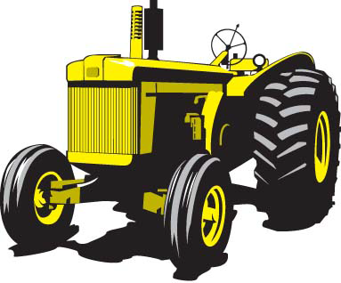
After World War II, Georgia experienced tremendous growth & transformation in several ways:
1. Changes in agriculture:
Tenant farmers were no longer needed because of:
A. The New Deal’s Agricultural Adjustment Act
B. A new invention ….

Slide 9
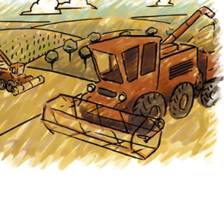
Changes in agriculture:
• Agriculture became focused on fewer but larger farms:
1945 – GA had 226,000 farms averaging 105 acres large
1969 – GA had 67,000 farms averaging 500 acres large

Slide 10
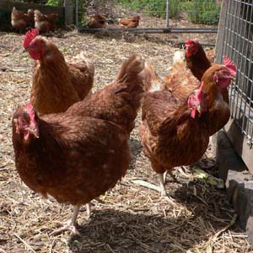
Farmers reduced the number of crops and turned to
a new product: = 1/3 of farm
output by 1970
Thousands of displaced farmers had to find work
elsewhere….

Slide 11
Match the cause on the left with its effect on the right
New systems of farming required less
2. Landowners did not have
enough money to pay
workers.
3. People moved to the
cities to find work.
Cities grew &
manpower prospered
B. Sharecropping developed
C. Tenant farming system
dissolved

Slide 12
TODAY, 80% OF THE NATION’S LARGEST BUSINESSES HAVE BRANCH OFFICES IN OR AROUND ATLANTA, INCLUDING…

Slide 13
MODERN GEORGIA (1940-Today):
The most widely recognized product in the world.

Slide 14
Invented by Atlanta pharmacist
Dr. John Pemberton, who mixed
coca leaf and kola nut extracts
• First sold at Jacob’s Pharmacy in
Atlanta in May 1886
• Purchased by Asa Candler in 1891,
who formed the Coca-Cola
Company in 1892
• Became an international product
under the leadership of Company
President Robert Woodruff

Slide 15
MODERN GEORGIA (1940-Today)
Behind every new business is an entrepreneur who takes a risk to produce goods and services.
The goal of every entrepreneur is to make a profit, a company’s earnings after all expenses are paid.
Often times, entrepreneurs will share the risk with other investors/lenders.
Other examples of successful risks include…

Slide 16
• Founded in 1927, by Owen R. Cheatham, as the Georgia Hardwood Lumber Company
• Cheatham used $6000 of his own money and $6000 from investors to start the business
• Renamed Georgia-Pacific in 1956
Today, it is one of the world’s largest manufacturers of forest products (I.e., bath tissue, paper, boxes, paper plates, etc.)

Slide 17
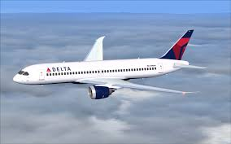
• Founded by crop-dusters, B.R. Coad and C.E. Woolman in the 1920s to fight the boll weevil
• Renamed Delta Air Service in 1928
• Moved to Atlanta in 1941 as an air passenger service
• Today, it is one of the world’s largest international airlines

Slide 19
Founded in the 1970s by Bernie Marcus and Arthur Blank to provide all home improvement
products in one single location
Home Depot now has over 1700 stores in the United States and across the world.
• Marcus and Blank’s influence led to the creation of other super chains (i.e., Wal-Mart, Lowes, Bass Pro Shop, etc.)

Slide 20
THIS MEANS….
GROWTH,
JOBS, and…

Slide 21
Movement and migration of ideas affect all
societies involved.
Technological innovations
have intended and unintended consequences.
What impact did technology have on Georgia’s farms?
How did changes on the farm effect Georgia's economy and the growth of Georgia’s cities?

